Slide 1
Current trends in FinTech
By Rik Choudhury

Slide 2
Financial Technology
Financial Technology describes a business that aims at providing financial services by making use of software and modern technology.
FinTech are disrupting traditional financial services, including mobile payments, money transfers, loans, fundraising, and asset management.
Notes:
fintech companies directly compete with banks in most areas of the financial sector to sell financial services and solutions to customers. Mostly due to regulatory reasons and their internal strucutres, banks still struggle to keep up with fintech startups in terms of innovation speed. Fintechs have realized early that financial services of all kinds – including money transfer, lending, investing, payments, ... – need to seamlessly integrate in the lives of the tech-savvy and sophisitcated customers of today to stay relevant in a world where business and private life become increasingly digitalized.

Slide 3
Global Fintech Investments (2018)
Notes:
Investments in FinTech’s have reached a new record last year. A whopping $112 billion was pumped into innovative companies that pursue technological innovation in the financial sector, a sharp increase compared to the $51 billion in the previous year.
The stellar growth globally is in large part the result of three mega deals of more than $ 10 billion: the $17 billion investment by Blackstone in Refinitiv, the $13 billion acquisition of UK’s WorldPay by Vantiv, and the $14 billion capital funding raised by Chinese firm Ant Financial.

Slide 4
Adoptability by country

Slide 5

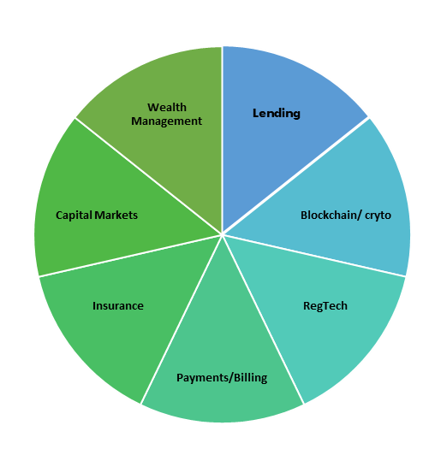
FinTech by activity
Lending: Marketplace lending & alternative underwriting platforms.
Block chain/Crypto: Companies leveraging blockchain technologies for financial services.
Wealth Management: Investment & wealth management platforms & analytics tools.
Capital Market: Sales & trading, analysis & infrastructure tools for financial institutions.
Regtech: Audit, risk & regulatory compliance software.
Payments & billing: Payment's processing, card developers & subscription billing software tools.
Insurance: Companies selling digitally or providing data analytics or software for (re)insurers.
Notes:
Personal finance: Tools to manage bills & track personal & credit accounts.
Money Transfer/Remittances: International money transfer & tracking software.
Mortgage/Real estate: Mortgage lending digitization & financing platforms.

Slide 6
Lending
 | FINTECH -FIN |  | FINTECH-TECH
 | P2P MARKETPLACE | ONLINE LENDING
BUSINESS MODEL | Individual investors & borrowers meet to realize money exchanges. | Investors, mostly institutional, lend money to borrowers. | Offers Advanced Credit Scoring, Credit Automation, NPL management & Regulatory monitoring/reporting (RegTech)
KEY FEATURE | Risk taken by the investors | Risk is transferred from the investor to the platform | Specialization of Services
YEARS OF ACTIVITY | 10 yrs old or even less | 10 yrs old even less | Some were founded in the ’80s
RELATIONSHIP WITH BANKS | Loans are generated by partner banks & then transferred through loan notes. | Represent an alternative to traditional lending offered by Banks | B2B approach. Fintech provide infrastructure to banks
Notes:
1. Fintech lending, sometimes referred to as online marketplace lending, is lending through digital platforms that often collect and base lending decisions on nontraditional data sources. Underwriting is typically automated and may employ nontraditional credit algorithms.
2. In the U.S. personal loan market, fintech lenders’ market share increased from less than one percent in 2010 to 36 percent in 2017. In the mortgage market, fintech lenders’ market share increased from two percent in 2010 to eight percent in 2016, with the total dollar volume of originations growing thirty percent annually.

Slide 7
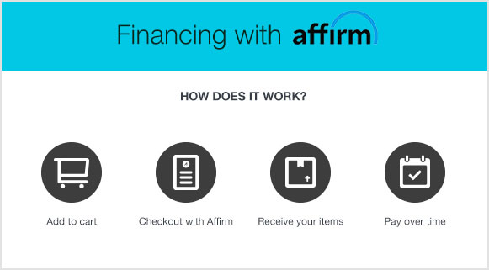
Affirm
The company operates as a financial lender of microloans for consumers to use at the point of sale to finance a purchase.
The company announced a partnership with Walmart in February 2019. Under the partnership, Affirm will be available to customers in store and on the Walmart website.
Since its founding, Affirm has partnered with e-commerce platforms including Shopify,BigCommerce, and Zen-Cart.
Notes:
the company operates as a financial lender of microloans for consumers to use at the point of sale to finance a purchase.
The company announced a partnership with Walmart in February 2019. Under the partnership, Affirm will be available to customers in store and on the Walmart website.
Since its founding, Affirm has partnered with e-commerce platforms including Shopify,[4] BigCommerce, and Zen-Cart.

Slide 8
Blockchain/Crypto
Lending
Blockchain/ cryto
RegTech
Payments/Billing
Capital Markets
Wealth Management
Insurance
Blockchain is a technology that utilizes a open decentralized ledger, where each information entity, known as a block, is cryptographically secure and is added to an ever-growing chain (secure linked list).
Blockchain is an open distributed ledger, and operates openly.
It can record transactions between two parties, quickly and efficiently.
By design, a blockchain is resistant to modification of data.

Slide 9
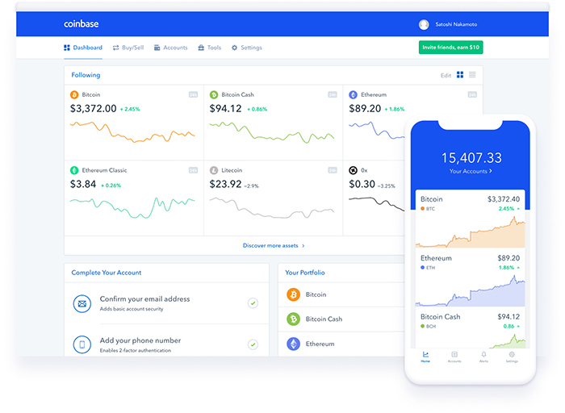
Coinbase is a global digital asset exchange company (GDAX), providing a venue to buy and sell digital currencies, as well as send information about those transactions out to the blockchain network to verify those transactions.
Coinbase serves as a wallet, too, where the digital currencies can be stored.
The application operates exchanges of Bitcoin, Ethereum, Bitcoin Cash and Litecoin
Coinbase requires you to link a bank account, or credit or debit card to your Coinbase account to purchase cryptocurrencies.
Notes:
Coinbase requires you to link a bank account, or credit or debit card to your Coinbase account to purchase cryptocurrencies.
Coinbase is a global digital asset exchange company (GDAX), providing a venue to buy and sell digital currencies, as well as send information about those transactions out to the blockchain network to verify those transactions.
Coinbase serves as a wallet, too, where the digital currencies can be stored.
The application operates exchanges of Bitcoin, Ethereum, Bitcoin Cash and Litecoin

Slide 10
Wealth Management
Lending
Blockchain/ cryto
RegTech
Payments/Billing
Capital Markets
Wealth Management
Insurance
FinTech can improve the client experience by tailoring solutions and services to their individual needs.
Robo-advisory constitutes automated digital wealth management platforms rather than physical robots.
Many points of contact across multiple devices that will have to be streamlined.
The asset allocation process can be customized and executed online.

Slide 11
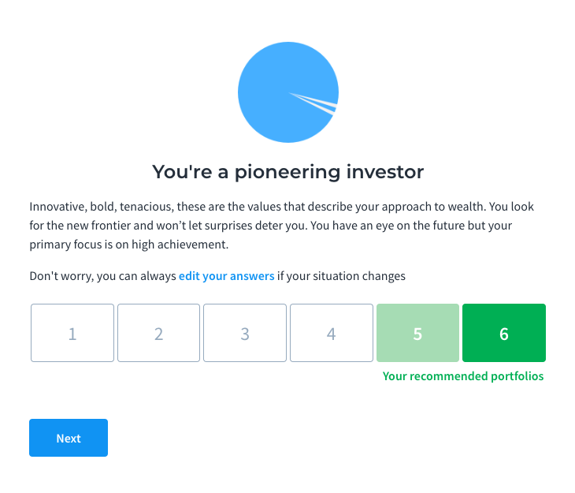
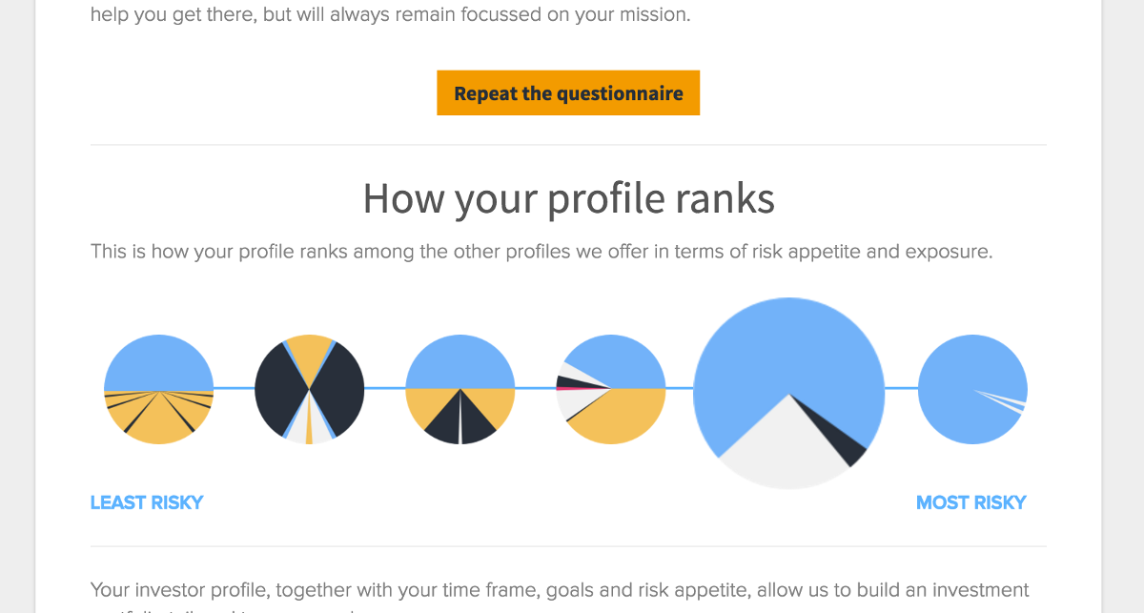
Moneyfarm is an online investment platform, which makes investing more accessible and easy-to-use for people at a low-cost.
Moneyfarm tends to focus mainly on exchange-traded funds (ETFs) in order to retain low fees.
You’ll need a minimum of £500 to invest, with Moneyfarm recommending you have at least £1,500 in your account so you can have a good mix of investment assets.

Slide 12
Capital Markets
Lending
Blockchain/ cryto
RegTech
Payments/Billing
Capital Markets
Wealth Management
Insurance
Access to connectivity
Alternative models
Changes in the ability of firms to access capital
Global regulatory model that has focused on risk mitigation

Slide 13

Generic risk platform providing market data management, basic portfolio management and a real time calculation engine.
Recently, the company has shifted to a SaaS model for providing services based on the Strata open source core.

Slide 14
Insurance
Lending
Blockchain/ cryto
RegTech
Payments/Billing
Capital Markets
Wealth Management
Insurance
Partnerships with product makers and distributors.
Technology advancements including AI innovations and algorithms will likely individualize risk selection and pricing.
Time-flexible, event-driven, modular and adjustable coverage.
Flexible term products.

Slide 15

ACKO
Private sector general insurance company in India.
Acko follows an online-led model and hence all operations for the company are offered through the digital platform
Founded in November 2016

Slide 16
RegTech
Regtech is the management of regulatory processes within the financial industry through technology.
Main functions of regtech include regulatory monitoring, reporting, and compliance.
RegTech use cloud computing technology through software-as-a-service (SaaS) to help businesses comply with regulations efficiently and less expensively.
Lending
Blockchain/ cryto
RegTech
Payments/Billing
Capital Markets
Wealth Management
Insurance

Slide 17
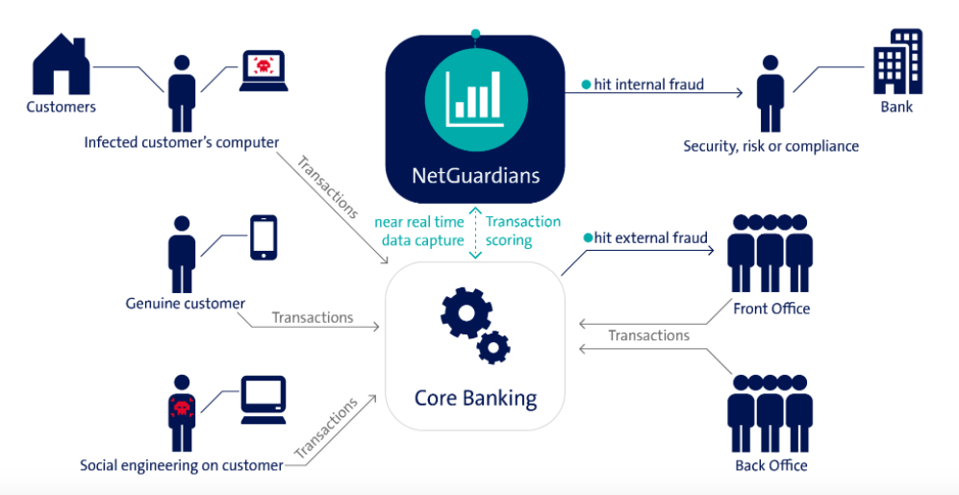
Notes:
Real-time banking fraud prevention

Slide 18
Payments/Billing
Lending
Blockchain/ cryto
RegTech
Payments/Billing
Capital Markets
Wealth Management
Insurance
Mobile payments rely on near field communication (NFC), tokenization, fingerprint readers and a mix of other technologies to provide a seamless option for users.
Leverage the wealth of data that retailers have about purchase history to craft a unique offer for each customer.
Make transactions easier & quicker for users

Slide 19
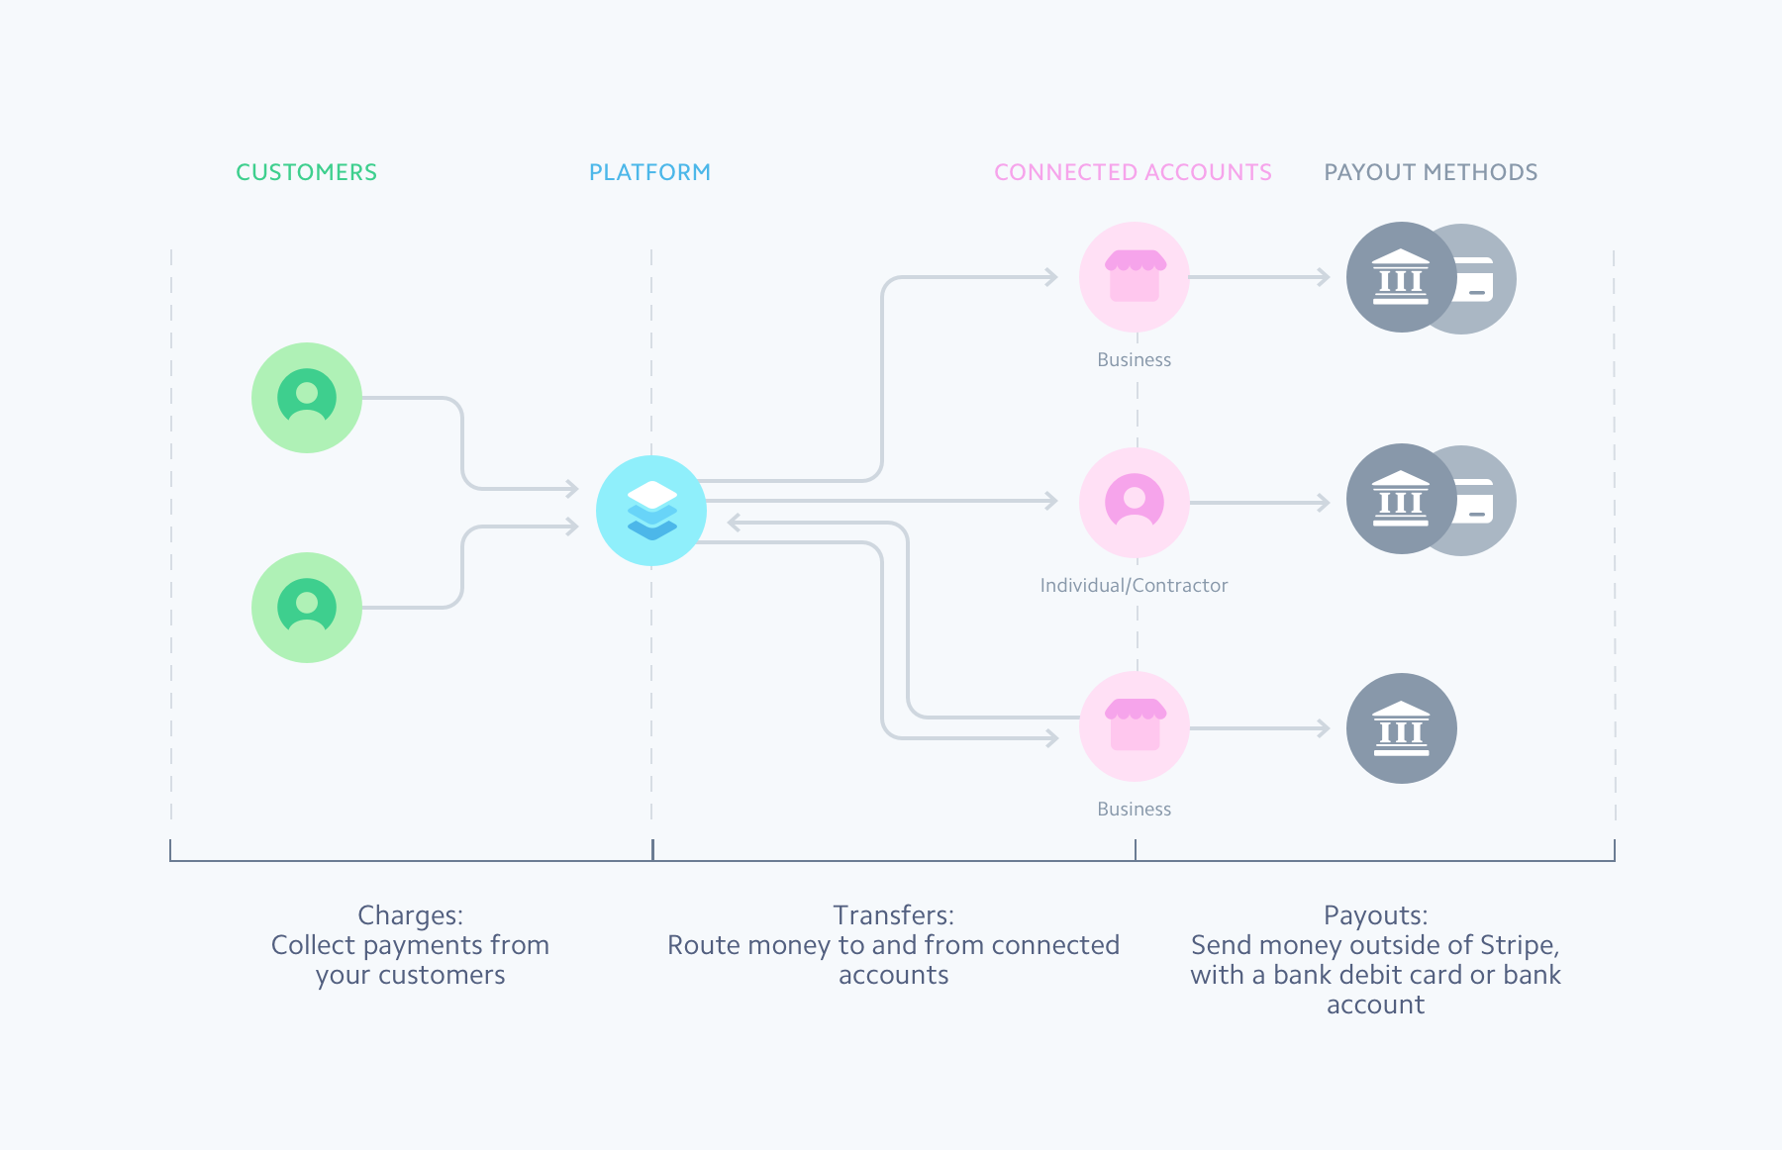
STRIPE
STRIPE software allows individuals and businesses to make and receive payments over the Internet.
Stripe provides the technical, fraud prevention, and banking infrastructure required to operate online payment systems.

Slide 20
Open Banking
Open banking is the practice of sharing financial information electronically, securely using application programming interfaces (APIs).
Open Banking API that would mean that bank would expose information to the API, which can be accessed through specific functions.
Users will be able to get a better deal.
Consumers will be able to see different information about their account in one place — even if they have several banks.

Slide 21

Fintech vs. Techfin
Fintech usually refers to an organization where financial services are delivered through a better experience using digital technologies to reduce costs, increase revenue and remove friction.
Techfin usually refers to a technology firm that finds a better way to deliver financial products as part of a broader offering of services.
BigTech companies will offer full banking services in the next 5 yrs.

Slide 22
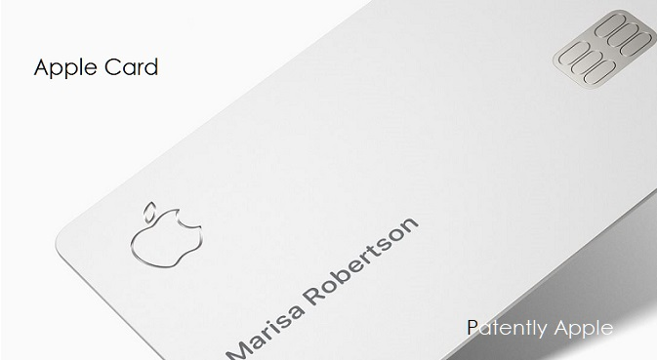
Competition
Google Apple Facebook Amazon plus Asian giants Baidu, Alibaba, Tencent are main competitors to fintechs
Amazon extended US$3bn in capital to business in US, UK & Japan.
Alibaba issues small business loans of about 63.4bn in 2017.
Apple’s credit card: Apple partner with Goldman Sachs and Mastercard
Notes:
Apple’s surprise announcement of the coming of Apple Card, which has sent the entire financial services industry into a frenzy.

Slide 23

Advantages of Techfin
Large & ever expanding customer base.
Low acquisition costs
Big data insights supporting pricing & risk management
Internet banking licences.
Out of this world customer experience.
Customers have emotional connection with tech brands.
Doesn’t see expanding into financial services as the final goal rather a tool to further increase customer loyalty.

Slide 24
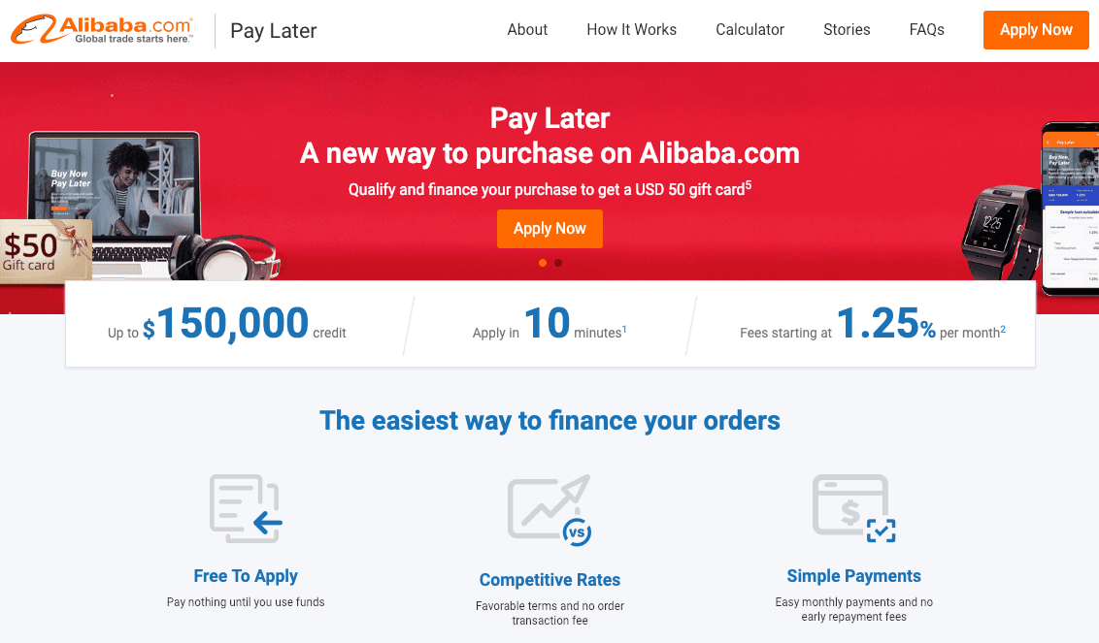
Collaborations
Alibaba & Kabbage
Notes:
Alibaba, for instance, has agreed with online lender Kabbage to offer point-of-sale loans of up to $150,000 to small businesses in the US to help them finance their orders on Alibaba.com in a new program called Pay Later. The collaboration also includes Kabbage’s Utah-based banking partner Celtic Bank, which issues all the fintech’s loans in the US, including those extended to Alibaba customers. Alibaba benefits from Kabbage’s capability to leverage big data and machine learning, and determine eligibility faster than a traditional bank. Meanwhile, Kabbage can connect directly with small companies looking for access to cash. As part of the deal, Celtic Bank can further increase the volume of credit it extends to customers through Kabbage.

Slide 25

JP Morgan Chase has joined forces with Amazon to issue credit cards with cash back to Amazon Prime members, gaining access to the sizeable market of some 100 million Amazon Prime customers worldwide.
Notes:
JP Morgan Chase, for example, has joined forces with Amazon to issue credit cards with cash back to Amazon Prime members, gaining access to the sizeable market of some 100 million Amazon Prime customers worldwide.

Slide 26
Fintech in Germany

Slide 27
Investments

Slide 28
12 new FinTechs in 2018
Focus shifting to Mature & scalable business models.
Push back from incumbent institutions launching their own digital offering.
Lack of funding & competition from foreign FinTechs.

Slide 29
FinTech Foundations
FinTech foundations by segment & B2B/B2C focus
Segment/B2B/B2C | 2013 | 2014 | 2015 | 2016 | 2017 | 2018
Payments | 3 | 5 | 6 | 3 | 1 | 0
Banking & Lending | 5 | 4 | 2 | 10 | 1 | 1
InvesTech | 3 | 9 | 8 | 8 | 0 | 0
PropTech | 0 | 4 | 1 | 3 | 5 | 1
Financing & Funding | 5 | 4 | 11 | 8 | 2 | 1
InsurTech | 3 | 5 | 13 | 12 | 6 | 2
Fin. eMarkets & Aggregators | 3 | 2 | 4 | 2 | 0 | 0
Enabling Process & Technology | 4 | 6 | 10 | 8 | 3 | 1
Financial Data Analysis | 0 | 1 | 4 | 1 | 3 | 0
RegTech | 0 | 2 | 5 | 4 | 1 | 0
B2B | 9 | 15 | 27 | 22 | 6 | 2
B2C | 13 | 20 | 29 | 29 | 7 | 4
B2B/B2C | 4 | 7 | 8 | 8 | 9 | 0

Slide 30
FinTech Failure in Germany
Lack of investor funding
High customer acquisition costs & lack of reach
Business model not scalable

Slide 31
Inter FinTech Activity
 |  |  | CORE
 |  | Payments | Banking & Lending | InvesTech | PropTech | Fundraising & Financing | InsurTech | Fin. eMarketplaces | Enabling Processess & Technology | Financial Data Analytics | RegTech | Cooperations
 | Payments |  |  |  |  |  |  |  | 2 |  |  | 2
 | Banking & Lending |  | 2 | 1 |  |  | 2 | 1 | 7 |  |  | 13
 | InvesTech |  |  |  |  |  |  |  |  | 1 |  | 1
Core | PropTech |  |  |  |  |  |  |  | 3 |  |  | 3
 | Fundraising & Financing |  |  |  |  |  |  |  | 6 |  |  | 6
 | InsurTech |  |  |  |  |  |  |  |  | 1 |  | 1
 | Fin. eMarketplaces |  |  |  |  |  | 2 | 1 | 2 |  |  | 5
 | Enabling Processes & Technology |  |  |  |  |  | 1 |  | 2 |  |  | 3
Enables | Financial Data Analytics |  |  |  |  |  |  |  | 3 |  |  | 3
 | RegTech |  |  |  |  |  |  |  |  |  |  | 0
 |  |  |  |  |  |  |  |  |  |  |  | 37
Broader customer reach.
Lower customer acquisition costs
High speed to market
Greater scalability potential

Slide 32




N26 Case
Fast growing FinTech founded in 2016.
Extended product offering in insurance, investment, payment & alternative credit portfolio
Internationalization: roll-outs expected in US
Cross segment partnership with other B2C FinTechs
N26
Barzahlen
TransferWise
raisin
vaamo
CLARK
auxmoney
Serves> 1mn customers
Active in more than 20 markets
Raised > USD200 mn
Employs ~ 500 ppl

Slide 33


FinTech internationalization (2018)
100
84

Slide 34
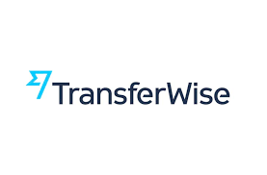
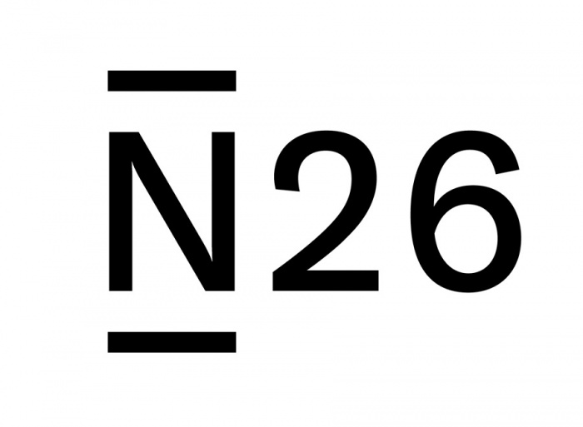








Most Active German Fintech
Foreign Fintech in Germany

Slide 35
Response of financial inst. To FinTech
Response of financial institutions to FinTech (2018)
Banks | Collaboration | Support programs | Investments | M&A | In-house innovations
Deutsche Bank | High | Med | Med | Low | Med
Commerzbank | Med | High | High | N.A. | Med
KFW | Low | N.A. | High | N.A. | N.A.
DZ Bank | Med | Low | Low | N.A. | Med
HypoVereinsbank | Med | Med | Low | N.A. | Low
LBBW | Low | Low | Low | N.A. | Low
BayernLB | Med | N.A. | N.A. | N.A. | N.A.
NORD/LB | Low | N.A. | Med | N.A. | N.A.
Helaba | Low | Low | Med | N.A. | N.A.
ING-DiBa | Med | Low | Med | Low | Med

Slide 36
Rise of financial ecosystem
1.Operators
Customers
Deutsche Bank
3.Participants
FinTechs
2.Facilitators
Banking
Deposit Solutions
Solaris Bank
Wealth Mgt.
Others
Allianz
Commerzbank
Insurance
ING DiBa

Slide 37
INB DiBa Case
SME Lending
Lendico – acquired in February 2018
FinCompare – Invested in June 2018
Payments
PAYVISION – payment processing platform
Payconiq- omni channel payment
Wealth Management
scalable Capital – Robo finn. advisor
ING Ventures
300 mil euro fund
Invests in Fintech
Builds portfolio to help ING accelerate.
Works with FinTechs like CLARK, Kaggabe, WeLab.

Slide 38
Summary
Market set to demonstrate greater maturity in coming years.
Foreign investments in German FinTech ecosystem will gain more momentum.
Focus stays on market tested & scalable business model.
Increased cross-segment cooperation.
Mature fintech will seek to leverage internationalization strategy.
B2C segment may see more failures due to increased competition from local & foreign FinTech's.
Relationship between FinTech & established financial institutes will evolve.

Slide 39

Thank You

